Slide 1

CS 261 – Hash Tables & Graphs
Oregon State University
School of Electrical Engineering and Computer Science
Spring 2013

Slide 2
Outline
Hash tables
Motivation
Terminology
Operations: Add, Search, Remove
Complexity
Exercises
Assignment 6 Q&A
Graphs: Depth First Search vs. Breath First Search

Slide 3
Hash tables - Motivation
To add, search and remove better than O(log n)
Example: Array:
If we want to store integers, use an array
A[i] = 0 => i is not in the list
A[i] = 1 => i is present in the list
Can be extended to A[i] = k, k occurrences of i
All operations are in O(1)
To extend this idea to non-integers
Let h() be a ‘hash function’ that converts a TYPE to an index (integer)
We can use this index to store the element in an array

Slide 4
Open addressing example
Data=[Kelley, Gilbert, Milam, Kidder, Stag]
Hash function h() uses the first character of the value (ASCII value)
The table size is 26.
Where does Kidder go?
K is occupied.. So take the next available spot which is ‘L’.
A B C D …… G … K … M … S … … …
Stag
Gilbert
Kelley
Milam

Slide 5
Chaining example
Kidder
Stag
Gilbert
Kelley
Milam
A B C D …… G … K … M … S … … …

Slide 6
Resolving collisions
Open addressing / probing
If h(x) is empty, add element at index h(x)
Else look for an empty spot ‘after’ h(x) and add element at the first empty spot
Wrap around
Chaining
Each index/bucket contains multiple elements represented as a suitable collection
Add element to collection at h(x)
Example: An array of lists

Slide 7
Terminology
Key and Value
The key (of type KeyType) and value (of type ValueType) being stored in the hash table
A pair of <key, value> forms an association
Hash function
Function that converts a key to an index
Hash index
location at which to store a key (or an association)
Load factor
number of elements / size of table
Collision
When two keys are hashed to the same index i.e. h(x) == h(y)

Slide 8
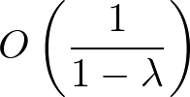

Complexity for Searching
Best case – each key maps to a unique index – O(1)
Worst case – All keys map to the same index – O(n)
Average case – Open addressing
Average case – Chaining
Smaller load factor, better performance.

Slide 9
Things to keep in mind
Is there a suitable h()?
How long does it take to compute h()?
What is the rate at which collisions occur?
What is the load factor?
Between 0 and 1 for open addressing
Can be greater than one for chaining
If load factor becomes too large
Resize the hash table
Rehash the data

Slide 10
Hash table question 1
A hash table has 11 slots, uses the hash function
h(x) = x mod 11,
What does the hash table look like after all of the following insertions occur: 3, 43, 8, 11, 14, 25, 23, 44 when:
open addressing is used?
hash table with buckets is used?

Slide 11
Solution
Open address
Index | Key
0 | 11
1 | 23
2 | 44
3 | 3
4 | 14
5 | 25
6
7
8 | 8
9
10 | 43
Bucket
Index | Key
0 | 44 ->11
1 | 23
2
3 | 25 -> 14 -> 3
4
5
6
7
8 | 8
9
10 | 43
Notes:
3, 43, 8, 11, 14, 25, 23, 44 when:

Slide 12
Hash table question 2
What is the load factor of this hash table?
Solution: 8/11
Open address
Index | Key
0 | 11
1 | 23
2 | 44
3 | 3
4 | 14
5 | 25
6
7
8 | 8
9
10 | 43
Notes:
λ = n / m
L = number of elements/size of table

Slide 13
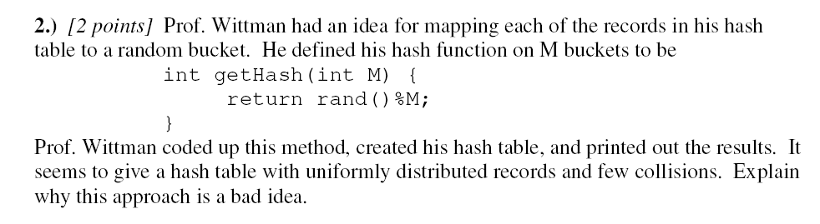
Hash table question 3
Notes:
When we try to find a particular record, the hash function will probably send us to the
wrong bucket. The hash function must be reproducible to make searches possible.
Three properties of a good hash function:
FAST (constant time)
Produce UNIFORMLY distributed indices
REPEATABLE (i.e., same key always results in the same index)

Slide 14
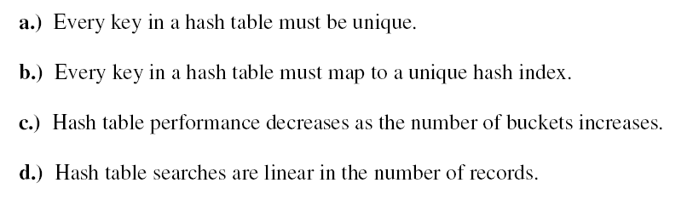
True or False?
Notes:
Every key in a hash table must be unique.
TRUE
b.) Every key in a hash table must map to a unique hash index.
FALSE. This is how we get collisions.
c.) Hash table performance decreases as the number of buckets increases.
FALSE. Performance generally increases with number of buckets.
d.) Hash table searches are linear in the number of records.
FALSE. With no collisions, searches are O(1). In general, a hash table search is
O(K) where K is the maximum number of records in one bucket.

Slide 15
Assignment 6: Hash Table Implementation of a Concordance
Table
0
...
1
next
...
2
Key
Value
3
4
D-1
...
struct hashMap {
hashLink ** table;
int tableSize;
int count;
};
struct hashLink {
KeyType key;
ValueType value;
struct hashLink * next;
};
Notes:
struct hashLink {
KeyType key; /*the key is what you use to look up a hashLink*/
ValueType value; /*the value stored with the hashLink, a pointer to int in the case of concordance*/
struct hashLink * next; /*notice how these are like linked list nodes*/
};
typedef struct hashLink hashLink;
struct hashMap {
hashLink ** table; /*array of pointers to hashLinks*/
int tableSize; /*number of buckets in the table*/
int count; /*number of hashLinks in the table*/
};

Slide 16
Hash Table: insert to hash map
Case 1- If the Key does not exist in the table, a new hashLink should be added.
...
...
...
Notes:
struct hashLink {
KeyType key; /*the key is what you use to look up a hashLink*/
ValueType value; /*the value stored with the hashLink, a pointer to int in the case of concordance*/
struct hashLink * next; /*notice how these are like linked list nodes*/
};
typedef struct hashLink hashLink;
struct hashMap {
hashLink ** table; /*array of pointers to hashLinks*/
int tableSize; /*number of buckets in the table*/
int count; /*number of hashLinks in the table*/
};

Slide 17
Hash Table: insert to hash map
2- The Key exists in the table, then the value of the corresponding hashLink should be replaced.
...
...
/* don't forget to free the memory pointed by old value */
free(temp->value);
temp->value=newValue;
...
Key
Value
Important Note: For the concordance application, when you want to increment the number of occurrences of a particular existing word, you can either use insertMap() to replace the old value OR just update the value as below:
int* occ = (int *)atMap(hashTable, “and”);
(*occ)++;
Notes:
struct hashLink {
KeyType key; /*the key is what you use to look up a hashLink*/
ValueType value; /*the value stored with the hashLink, a pointer to int in the case of concordance*/
struct hashLink * next; /*notice how these are like linked list nodes*/
};
typedef struct hashLink hashLink;
struct hashMap {
hashLink ** table; /*array of pointers to hashLinks*/
int tableSize; /*number of buckets in the table*/
int count; /*number of hashLinks in the table*/
};

Slide 18
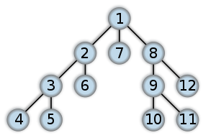

Graph: Reachability Problem
Given a single starting vertex, produce the set of vertices that can be reached starting from the initial location.
A depth-first search follows each path as far (deep) as possible before backtracking.
A breadth-first search looks at all possible paths at the same time.
Order in which nodes are reached: (left) DFS; and (right) BFS. Source: Wikipedia
Notes:
“DFS could be simulated as an ant walking along the edges of the graph, and returning to a previous node when it discovers it has reached a vertex it has already seen.”
“A mental image for BFS would be to pour ink at the starting vertex, and see where it travels along all possible paths”
18

Slide 19
Graph: Reachability Problem
findReachable (graph g, vertex start) {
create a set of reachable vertices, initially empty. call this r.
create a container for vertices known to be reachable. call this c
add start vertex to container c
while the container c is not empty {
remove first entry from the container c, assign to v
if v is not already in the set of reachable vertices r {
add v to the reachable set r
add the neighbors of v to the container c
}
}
return r
}
DFS: Container is a Stack
BFS: Container is a Queue
Notes:
19

Slide 20
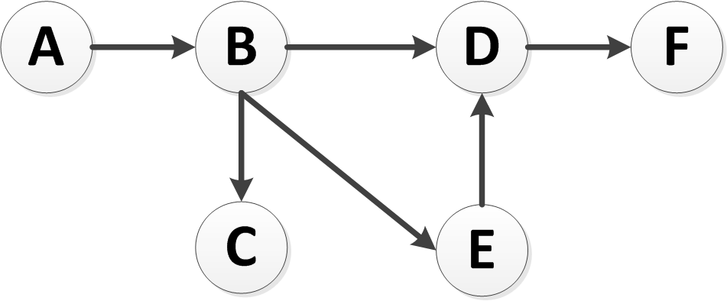
Exercise
Simulate the DFS and BFS on the following graph starting at node A.
Notes: (1) Nodes must be added to the container (Stack or Queue) in COUNTER-CLOCKWISE order; (2) We do not add neighbors to the container if they have already been visited.
Notes:
DFS:
r = {}; c = {A};
r={A}; c = {B};
r={A, B}; c={C, E, D}; // Note: D is the top of the stack
r={A, B, D}; c={C, E, F};
r={A, B, D, F}; c={C, E};
r={A, B, D, F, E}; c={C};
r={A, B, D, F, E, C}; c={};
BFS
r = {}; c = {A};
r={A}; c = {B};
r={A, B}; c={C, E, D}; // Note: C is the front of the queue
r={A, B, C}; c={E, D};
r={A, B, C, E}; c={D, D};
r={A, B, C, E, D}; c={D, F};
r={A, B, C, E, D}; c={F};
r={A, B, C, E, D, F}; c={};
20

